Slide 1
Introductory Workshop in Bioinformatics
WPM18: Protein Misfolding and Aggregation in Neurodegenerative Diseases
Dr. Jenny Russ
5.9.2022

Slide 2
Introduction
Who am I and who are you?
What is Bioinformatics and why is it useful?
Examples of using Bioinformatics in my research
Introduction to R and its application in analyzing biomedical data
Introduction to R and Bioconductor – From installation to your first simple R script
Data structures and fundamental programming structures
Analyzing generic tabular numeric datasets in R – Tidyverse introduction
Analyzing biomedical data with tidyverse – Luminescence-based Tau aggregation assay

Slide 3
Short introduction of myself
MSCA Fellow – Identifying epigenetic changes at onset of disease in neurodegenerative disease models (mainly Genomics assays such as single cell and bulk RNA-seq and ATAC-seq, ChIP-seq/CUT&Tag)
Background: BSc in Bioinformatics (2006), MSc in Molecular Medicine (2008) and PhD in Molecular Biology (2012)
Questions?

Slide 4
Please introduce yourself and let us know about your experience in computer science and bioinformatics

Slide 5
What is Bioinformatics?

Slide 6
What is bioinformatics?
Data Science
Comp. Science
Statistics
Bioinformatics
Comp. Biology
Biostatistics
Biology

Slide 7
Bioinformatics can be defined as…
“the application of computational tools to organize, analyze, understand, visualize and store information associated with biological macromolecules”
Bilotta, M., Tradigo, G. & Veltri, P. Bioinformatics Data Models, Representation and Storage. in (eds. Ranganathan, S., Gribskov, M., Nakai, K. & Schönbach, C. B. T.-E. of B. and C. B.) 110–116 (Academic Press, 2019). doi:https://doi.org/10.1016/B978-0-12-809633-8.20410-X.

Slide 8
Bioinformatics is open source science
Thousands of public databases

Slide 9
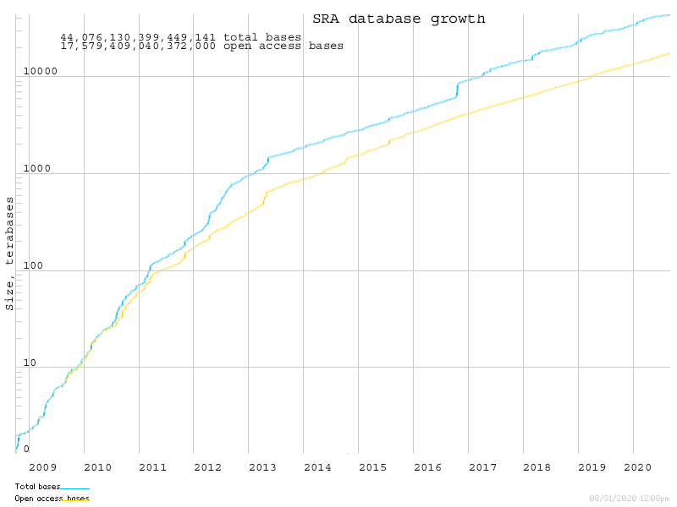
SRA = Sequencing Read Archive
> 11 PB of data!
Log scale…
https://www.ncbi.nlm.nih.gov/sra/docs/sragrowth/

Slide 10
Bioinformatics is open source science
Thousands of public databases
Millions of data samples freely available
Code is (usually) freely available
Training resources are (often) freely available
Result: Bioinformatics is only becoming bigger and more useful every year because it is (largely) open source

Slide 11
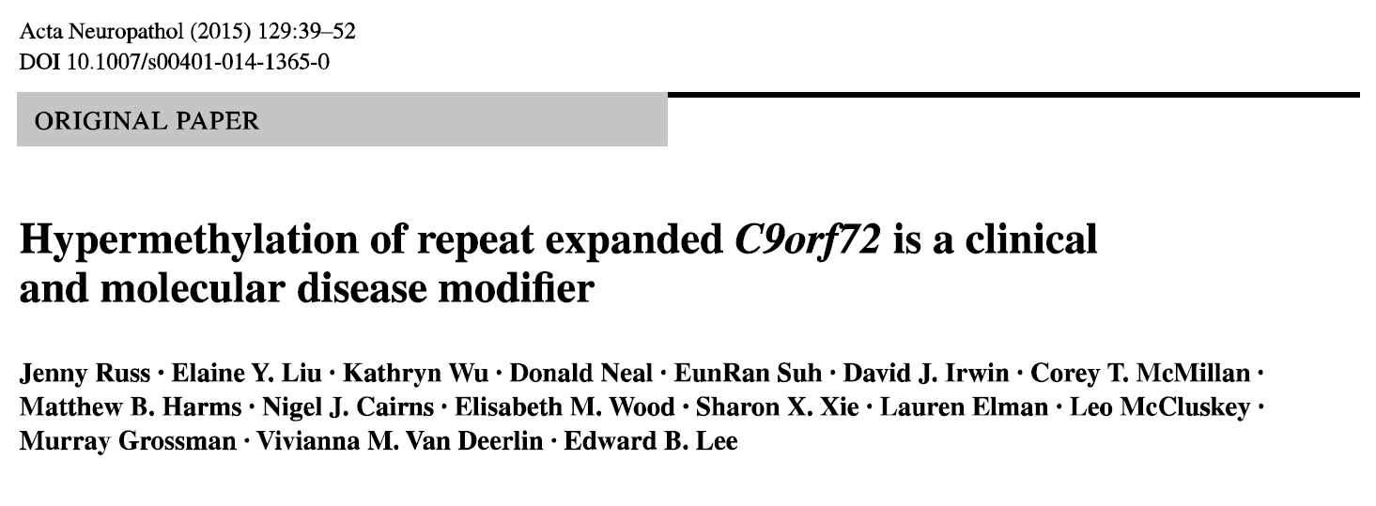
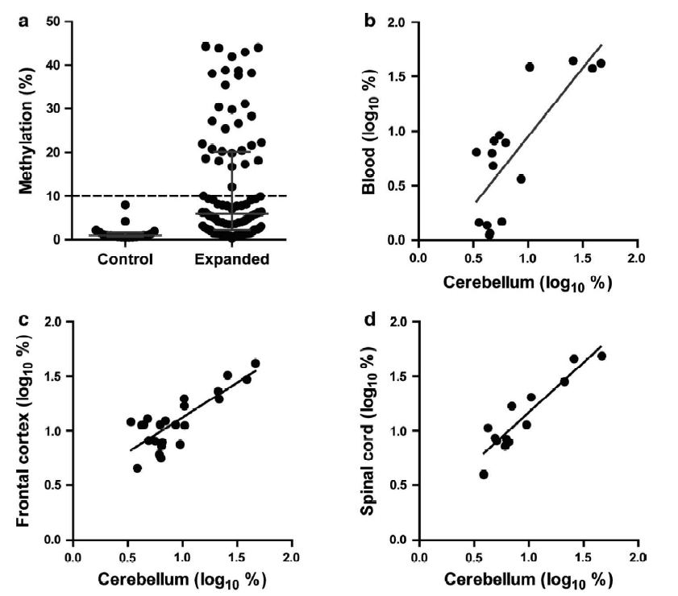
Where do I apply Bioinformatics?
Wilcoxon Rank Sum test: p < 0.001 (Comparing two groups)
R² = 0.621, p = 0.003 (Correlation test)

Slide 12
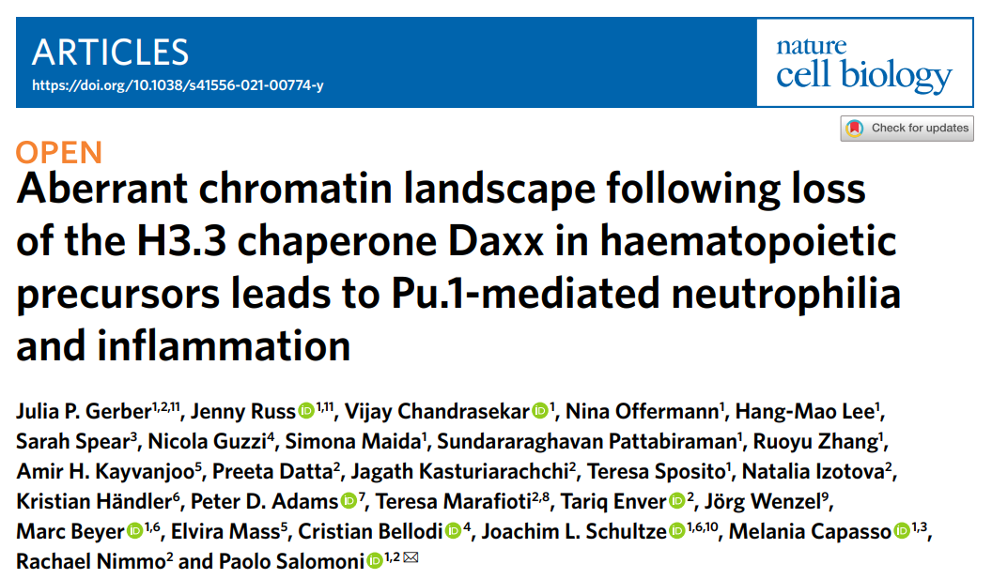
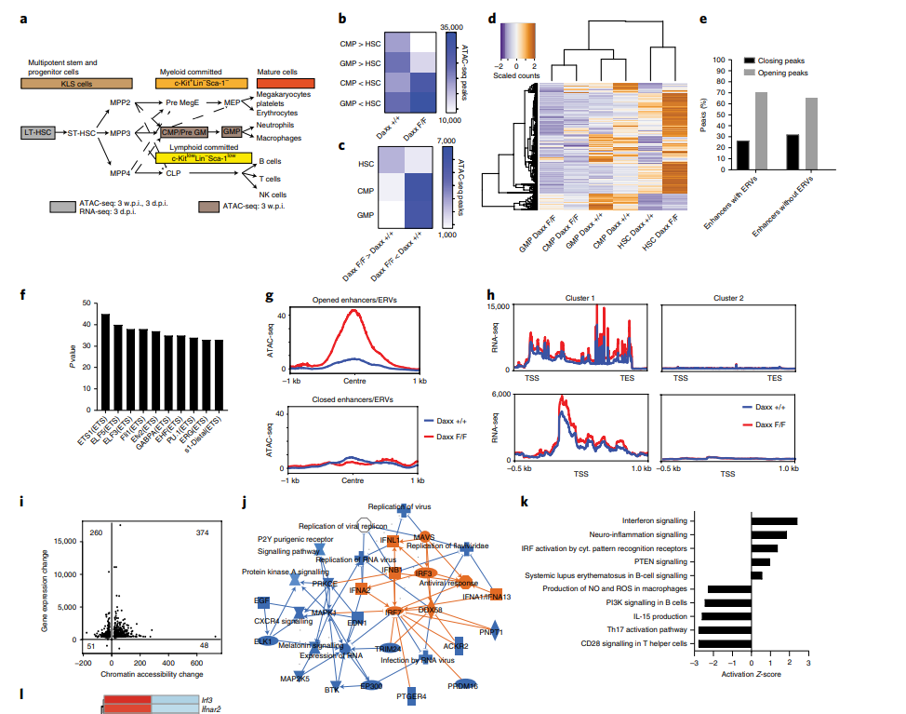
Where do I apply Bioinformatics?

Slide 13
Single nuclei RNA-seq of hippocampi isolated from C57BL/6 mice inoculated with normal brain homogenate (NBH) or RML prions (RML)

Slide 14
Introduction to R

Slide 15

What is R?
Programming language first released in 1995
Open-source derivative of Bell Lab’s “S” language
Features:
Object oriented
Interpreted (not compiled!)
Designed for statistical computing
Easily extended with packages
https://www.r-project.org/

Slide 16
R can be used for…
Electrophysiology Analysis
RNA-Seq / scRNA-Seq
Protein Interaction network analysis
Literature Mining
Drug PK/PD and synergy analysis
ChIP-Seq / HiC-Seq
Structural modeling
Population health
Machine learning
Etc…
Image processing
Clinical data analysis

Slide 17
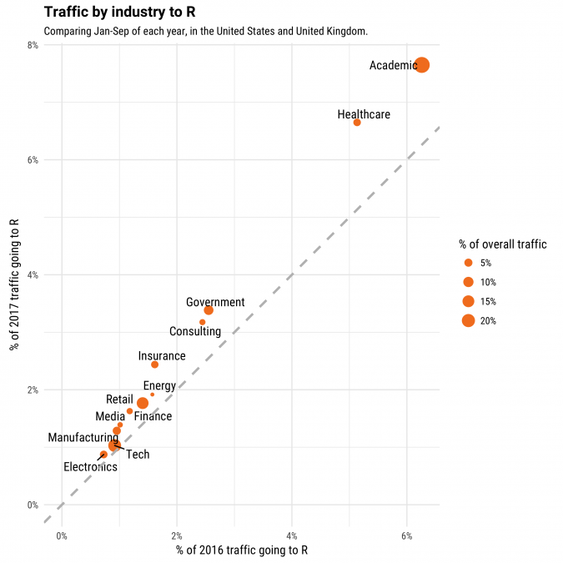
Why learn R?
Academic research is the largest area of R usage
https://stackoverflow.blog/2017/10/10/impressive-growth-r/

Slide 18

R-based Bioconductor is the leading repository of bioinformatics software
https://blog.f1000.com/2016/07/14/going-with-the-workflow-an-interview-with-bioconductor/

Slide 19
















Is the popularity of Bioconductor increasing over time?

Slide 20
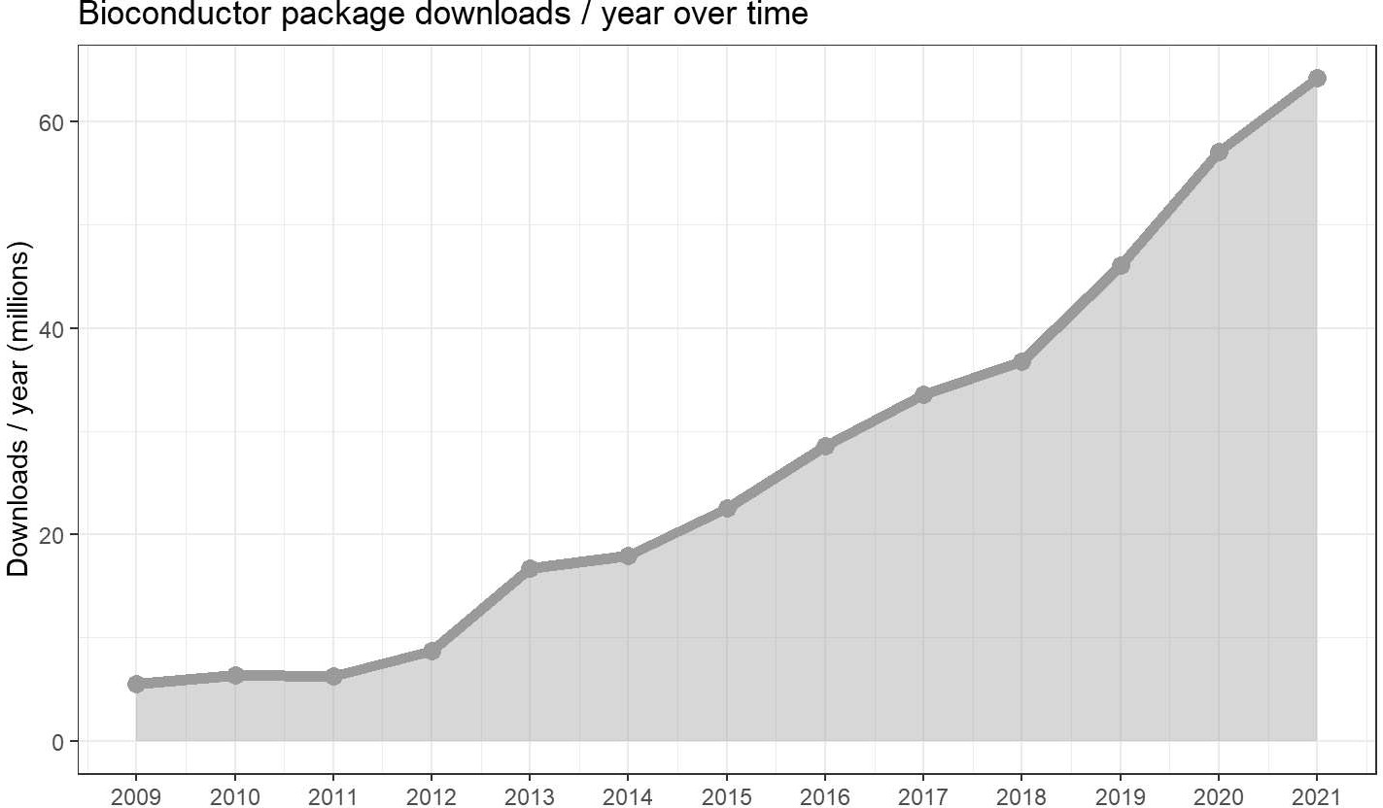
Is the popularity of Bioconductor increasing over time?

Slide 21
Setting up R

Slide 22
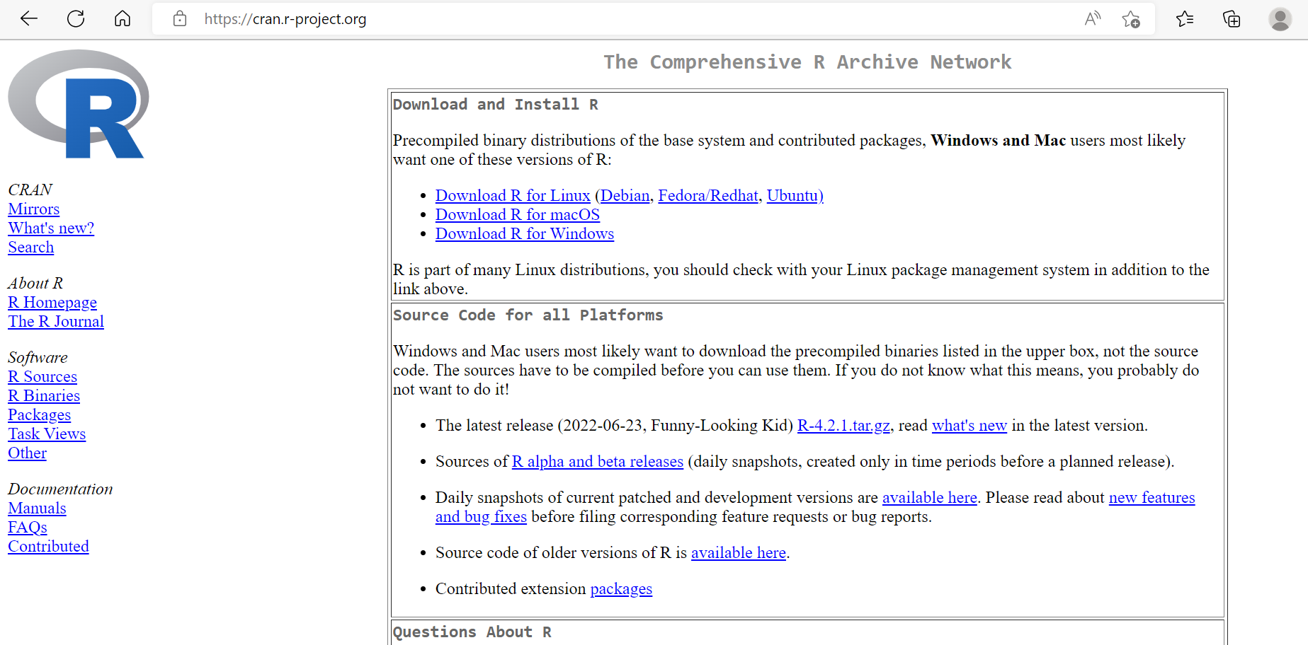

Slide 23
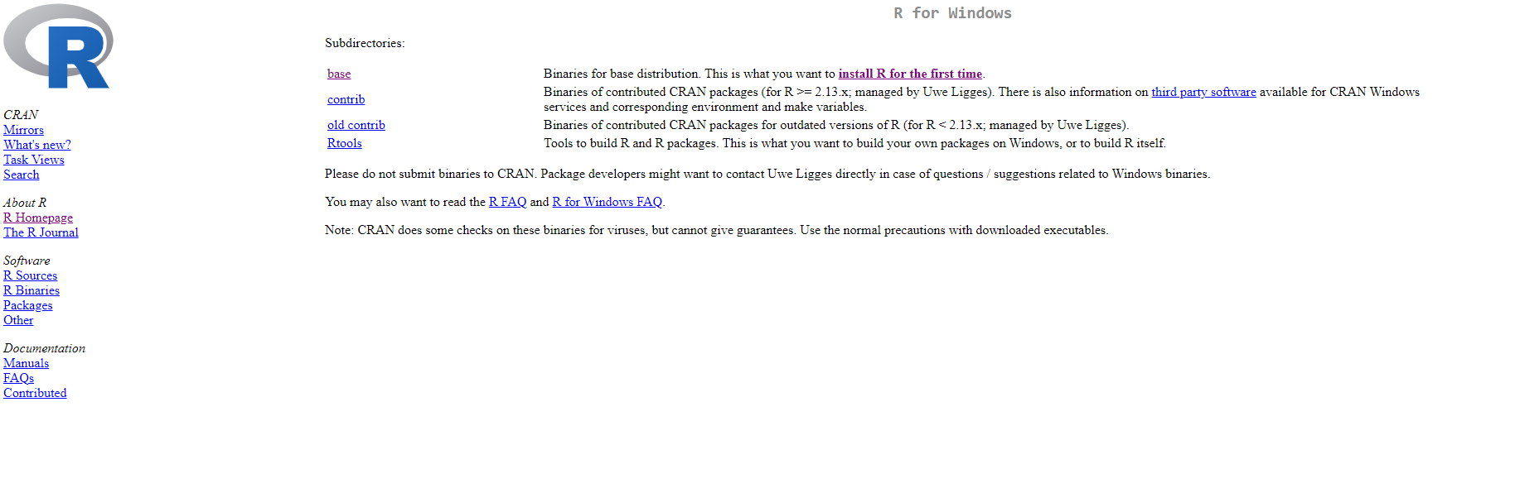

Slide 24
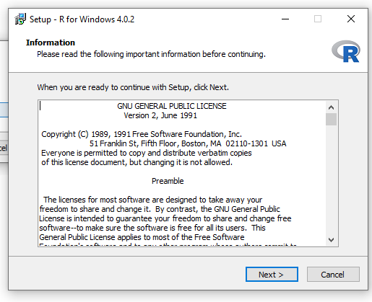

Slide 25
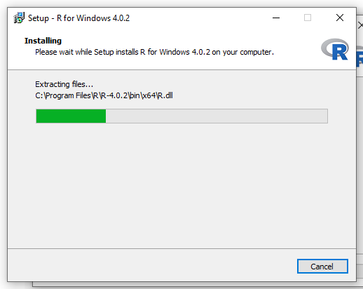

Slide 26
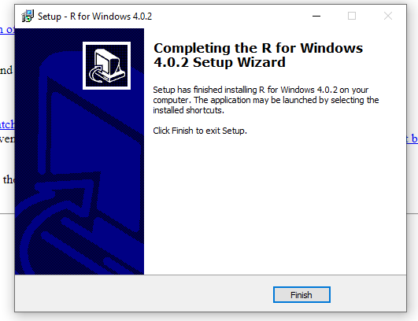

Slide 27
Setting up RStudio

Slide 28
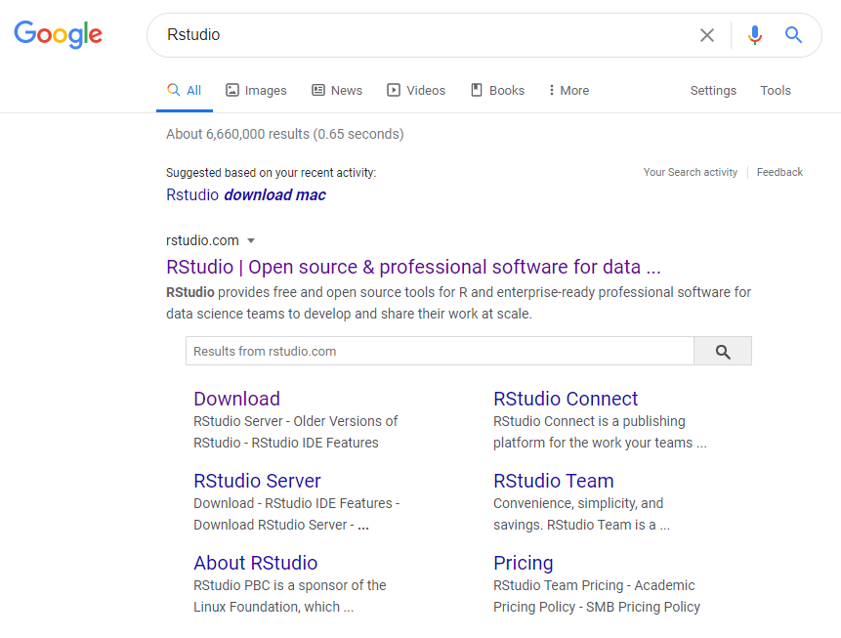

Slide 29
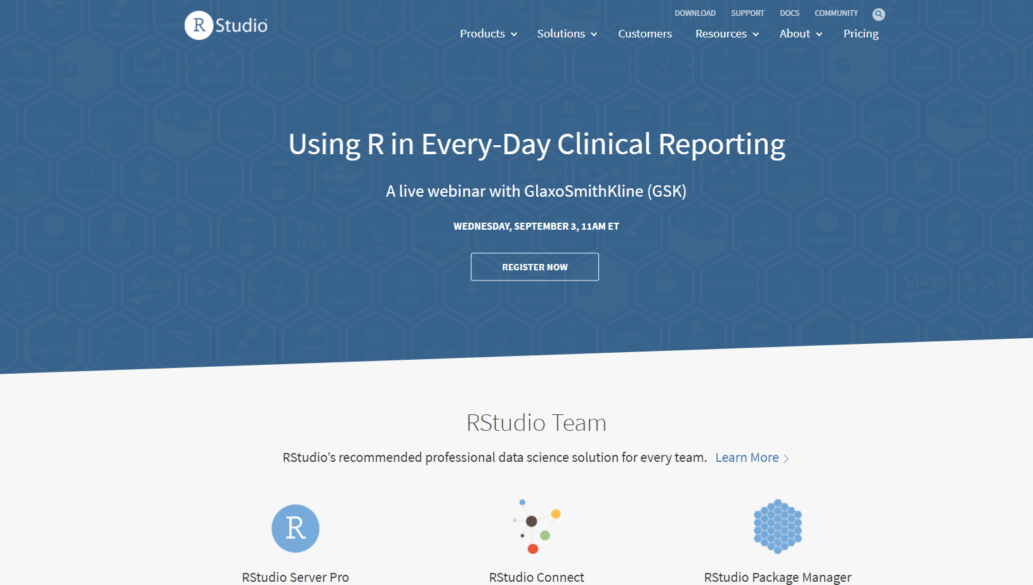

Slide 30
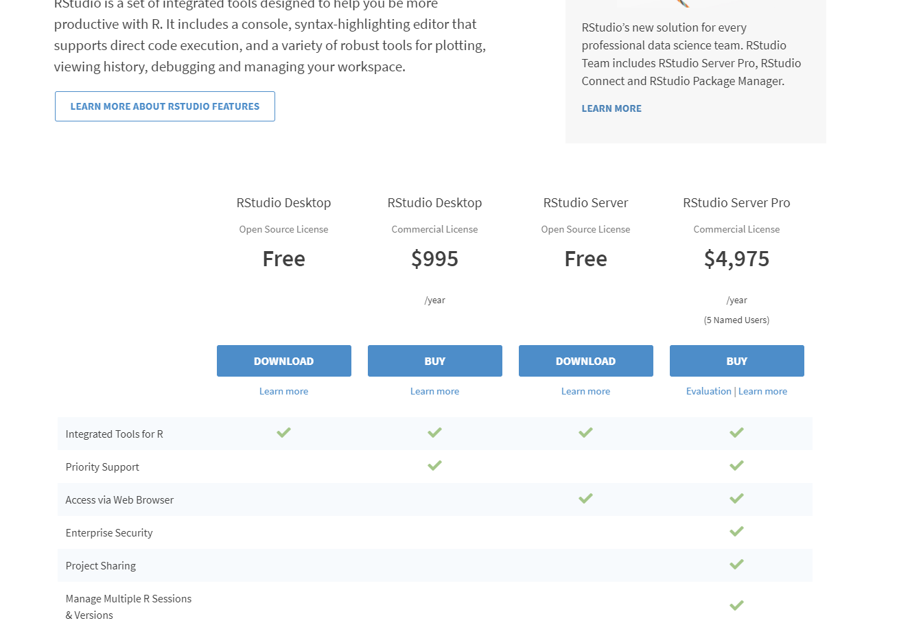

Slide 31
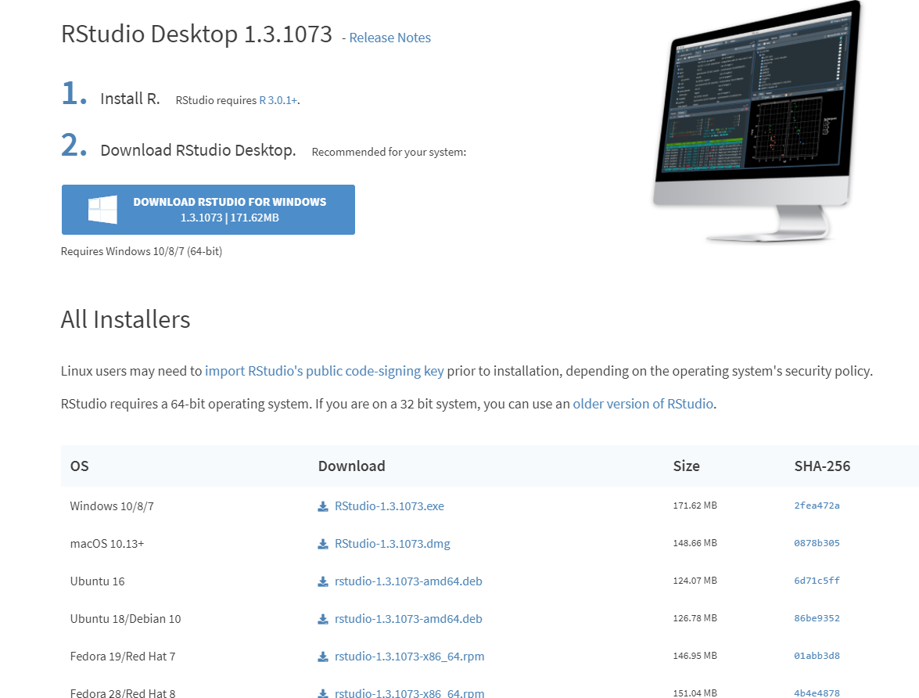

Slide 32
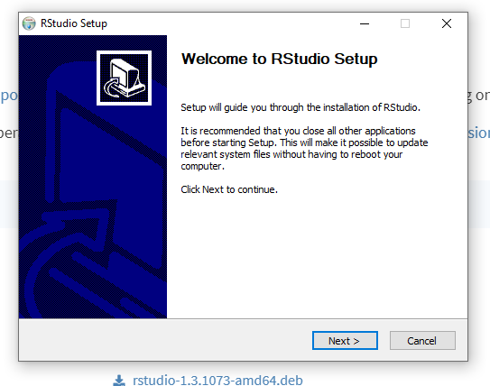

Slide 33
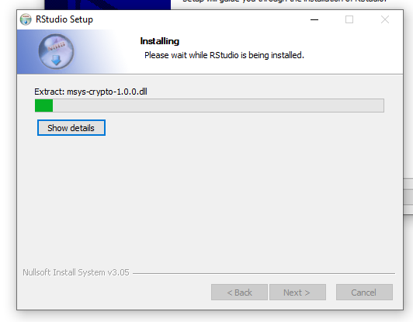

Slide 34
Run RStudio

Slide 35
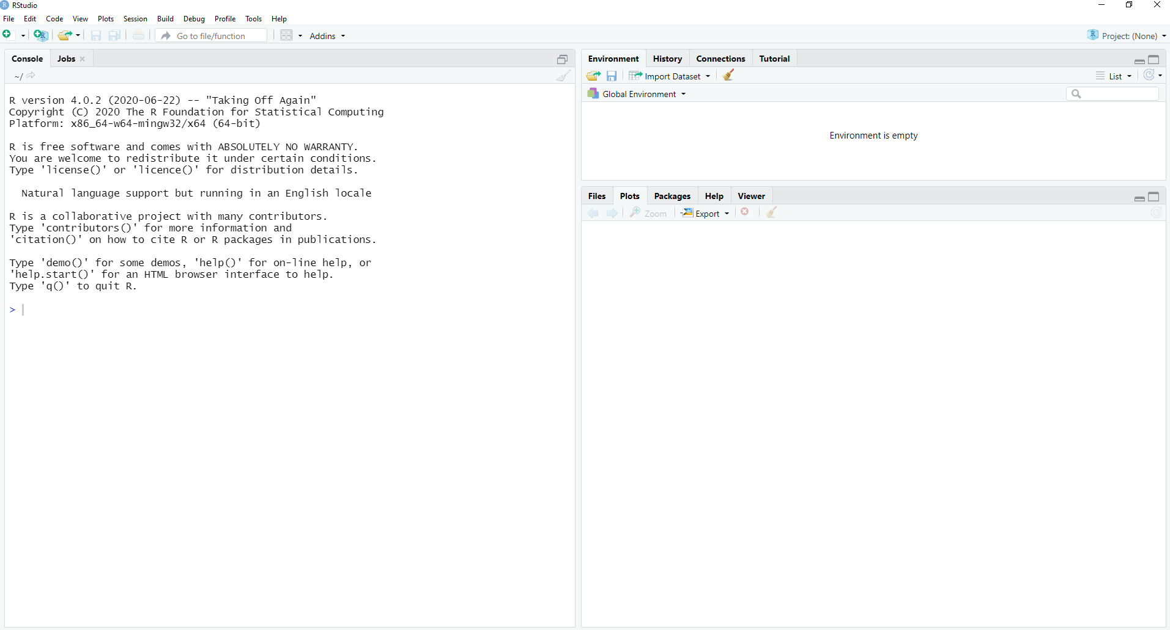

Slide 36
Questions?
10 min break

